Slide 1
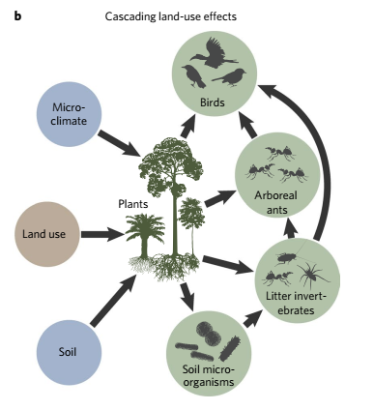



Structural Equation Modeling (SEM)
Modeling complex relationships in nature
Fernanda Alves Martins |fer.alves.martins@cibio.up.pt
Javier Martínez Arribas |javimartinezarribas@cibio.up.pt
Barnes et al. Nature Ecology and Evolution (2017)

Slide 2




Learn more about the TROPIBIO project…
https://cibio-tropibio.pt/en/
https://www.facebook.com/TROPIcal.BIOdiversity
https://www.instagram.com/tropibio21/
https://twitter.com/Tropibio21

Slide 3
Presentations
Your name
Your study system and
What motivated you to take this course?

Slide 4

Before we begin, you should know that…
Statisticians (and biologists) aren't very good at naming (just kidding :P)
In this course you will find a dozen terms that are often synonymous. But don't worry, I'll let you know when that happens

Slide 5
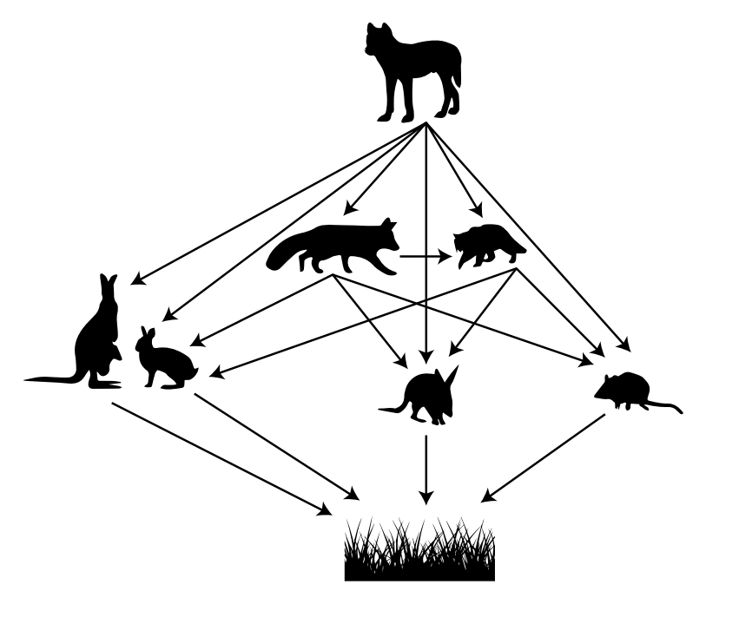
What are SEM?
SEM is not a single statistical technique
SEM is a statistical framework that allows one to analyze and test complex relationships between variables (Grace, 2006)
It is called “SEM” because it integrates several equations (i.e., models) simultaneously, allowing one to test multiple hypothesis
It provides a more comprehensive analysis of the relationships between the variables and the system studied
Geary et al., 2020 Nat Ecol Evol

Slide 6
SEM history (Jon Lefcheck presentation on ESA – https://www.youtube.com/watch?v=VT-gw_VVP1E&t=2514s)
First generation of SEM – Path analysis (Sewall Wright)
Second generation of SEM – Path analysis + Factor analysis
Covariance-based SEM – Global approach
Global estimation of a variance-covariance matrix
lavaan package
Third generation of SEM – Graph theory
Graph theory-based SEM – Local approach
Local estimation of each equation
Greater flexibility to accommodate ecological data of different natures
piecewiseSEM package

Slide 7
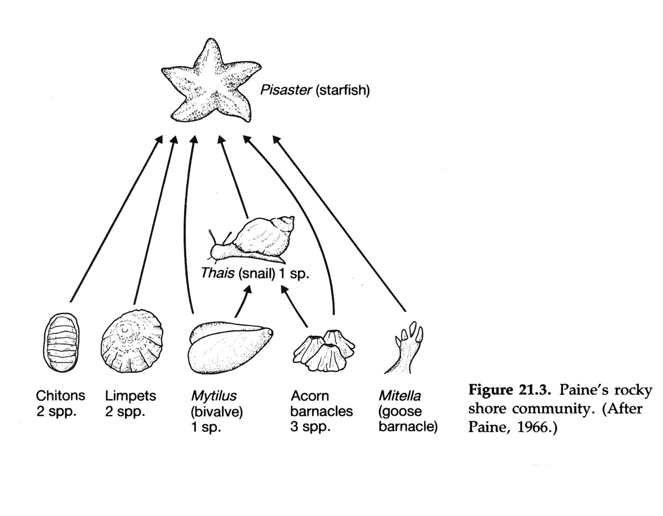

Why are SEM popular in ecology? (Jon Lefcheck presentation on ESA – https://www.youtube.com/watch?v=VT-gw_VVP1E&t=2514s)
science.umd.edu
Robert T. Paine

Slide 8
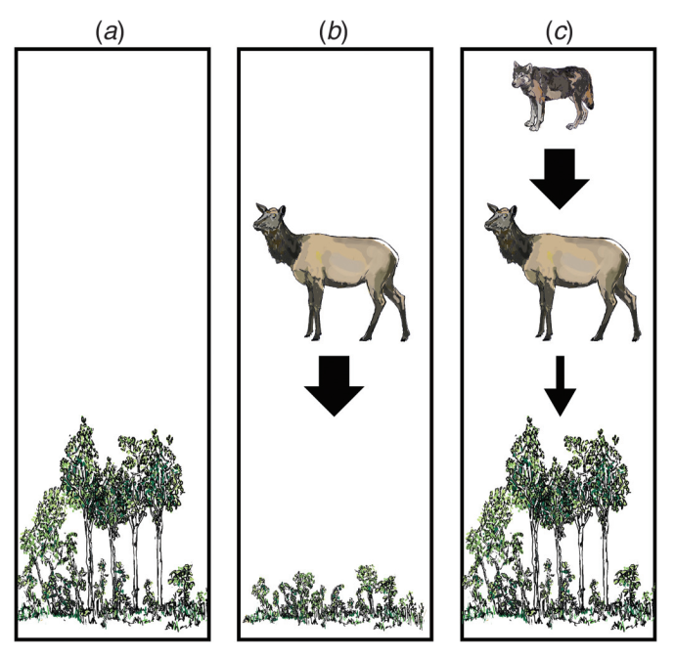

Why are SEM popular in ecology?
Ecology seeks to understand the vital connections between plants and animals and the world around them
(ESA definition- https://www.esa.org/about/what-does-ecology-have-to-do-with-me/)
Ecological relationships are often complex
(Eq.) Plants ~ Ungulates + Wolves
OR
(Eq. 1) Plants ~ Ungulates
(Eq. 2) Ungulates ~ Wolves
Beschta et al., 2016 NRC Research Press

Slide 9
set.seed(123)
n <- 100
# Data generation
wolves <- rnorm(n, mean = 10, sd = 3)
ungulates <- 150 - 10 * wolves + rnorm(n, mean = 0, sd = 20)
plants <- 50 + 5 * wolves - 2 * ungulates + rnorm(n, mean = 0, sd = 5)
data <- tibble(
wolves = round(wolves),
ungulates = round(ungulates),
plants = round(plants)
)

Slide 10
round(cor(data),2) # Multiple linear regresion m1 <- lm(plants ~ ungulates + wolves, data) summary(m1) plot(m1) # Path analysis model <-’plants ~ 1 + ungulates + wolves' m2 <- sem(model,data=data) summary(m2,fit.measures=TRUE) #We explain the distinct variances and covariances of the three observed variables #by the same number of parameters in the model.

Slide 11
# Mediation model model <- ' # Direct path plants ~ c*wolves # Path through mediator: Herbivores ungulates ~ a * wolves plants ~ b * ungulates # Indirect effect (a*b) indirect := a*b # Total effect total := indirect + c ' m3 <- sem(model, data=data, std.lv=TRUE) summary(m3,fit.measures=TRUE, standardized=TRUE)

Slide 12
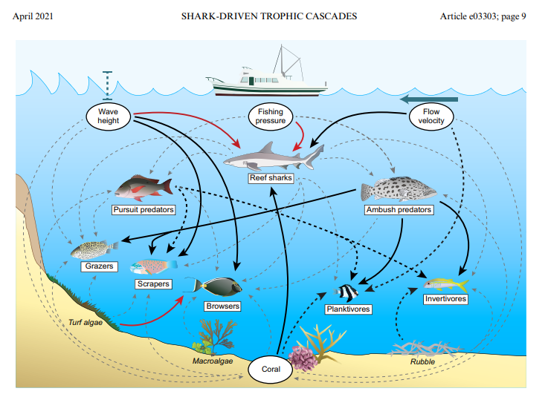
Applications in natural sciences
Trophic interactions
Desbiens et al., 2021 Ecology:
Top-down (reef sharks) or bottom-up (physical processes) controls coral reef fish assemblages?

Slide 13

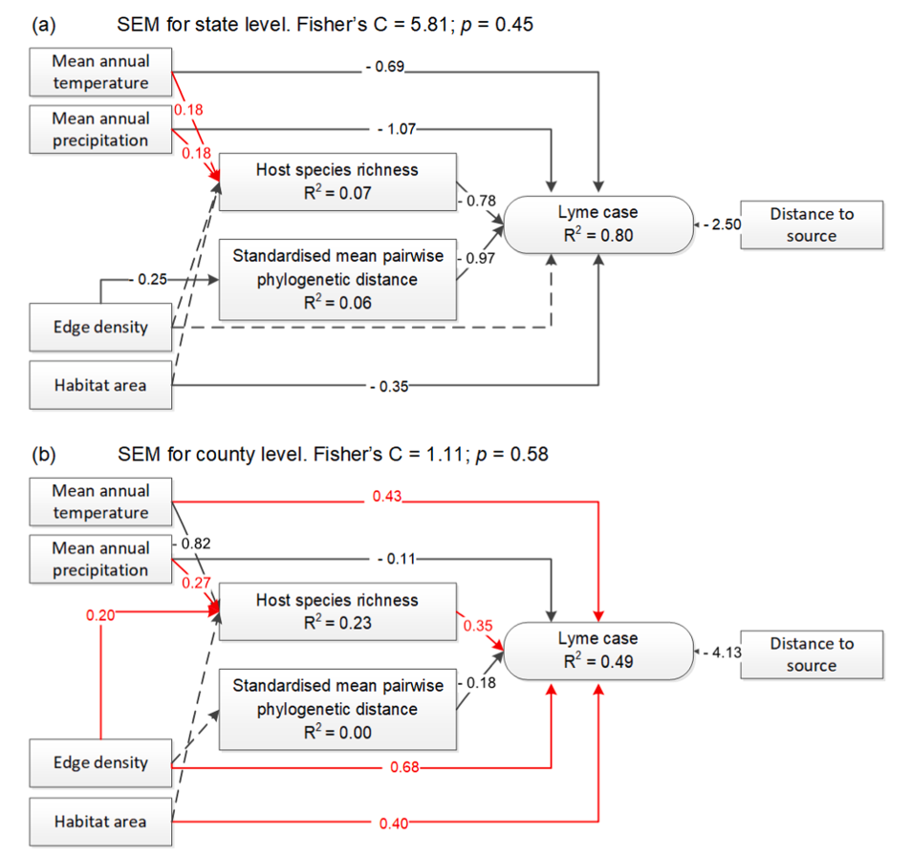
Applications in natural sciences
Evolutionary ecology / Epidemiology
species assemblages with more related species→ more Lyme disease cases in humans
greater variety of host species → fewer cases of Lyme disease (a dilution effect due to the presence of reservoir-incompetent species).
more rodent species increased the risk of Lyme disease

Slide 14
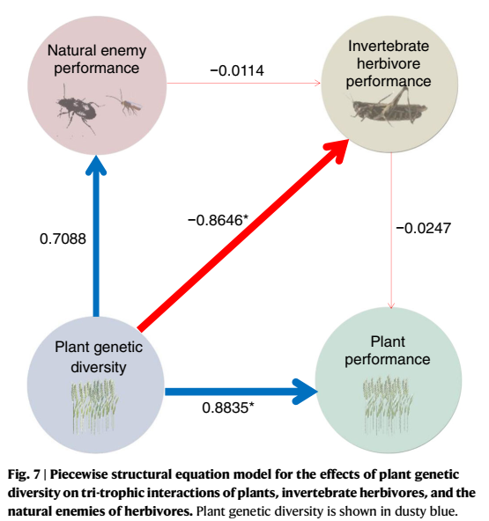
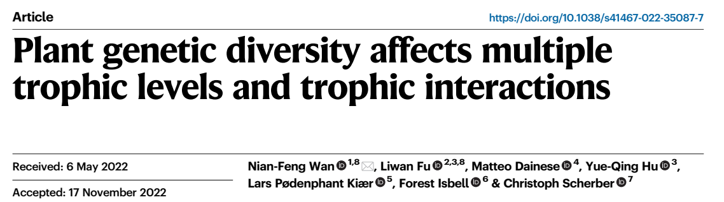
Applications in natural sciences
Evolutionary ecology / Diversity
increasing plant genetic diversity decreased the performance of plant antagonists including invertebrate herbivores, weeds, plant-feeding nematodes and plant diseases, while increasing the performance of plants and natural enemies of herbivores.

Slide 15
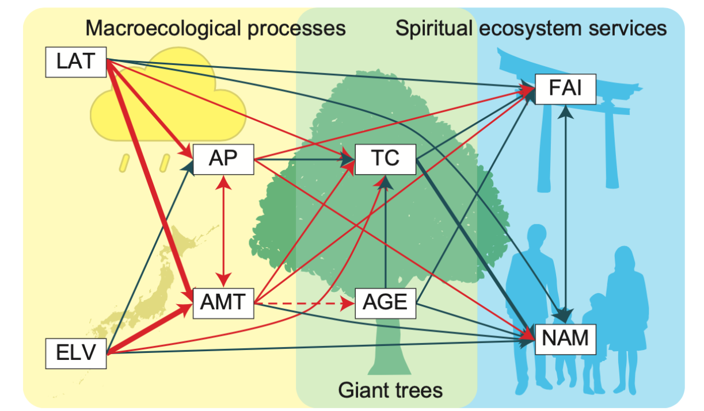

Applications in natural sciences
Macroecology
the sizes and distributions of giant sacred trees and the provision of spiritual ecosystem services are influenced by macroecological processes

Slide 16
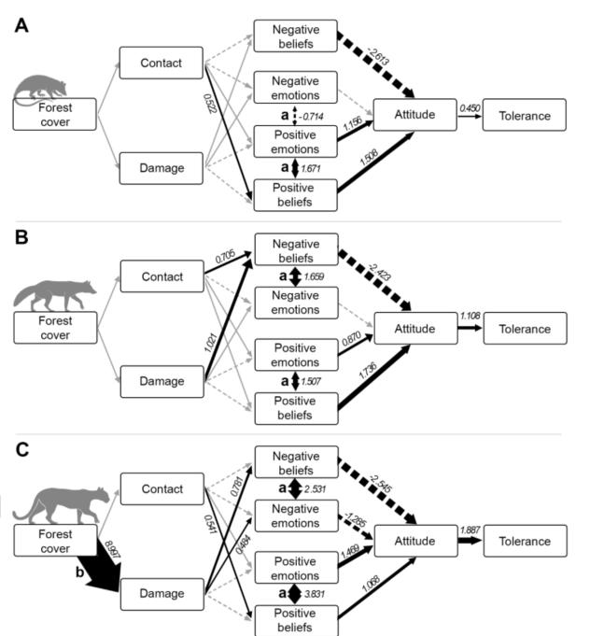
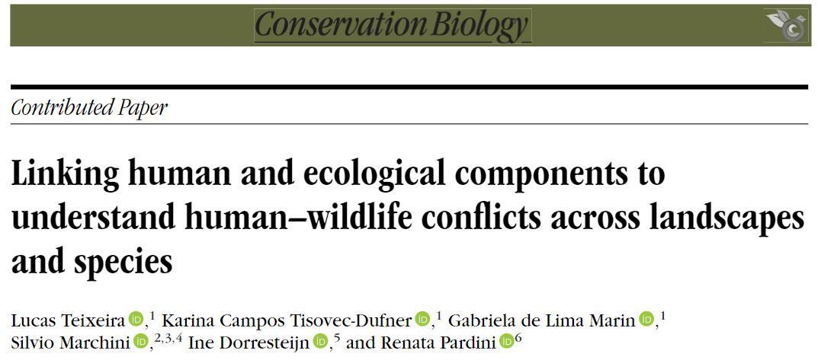
Applications in natural sciences
Conservation
native forest cover affects the contact people have with mammals and/or damage resulting from attacks to livestock;
if these experiences affect positive and/or negative beliefs and emotions towards mammals; and
which of these beliefs and emotions shape attitude and tolerance towards them
Forest cover increased Puma attacks to livestock and negative emotions were relevant only for the puma

Slide 17
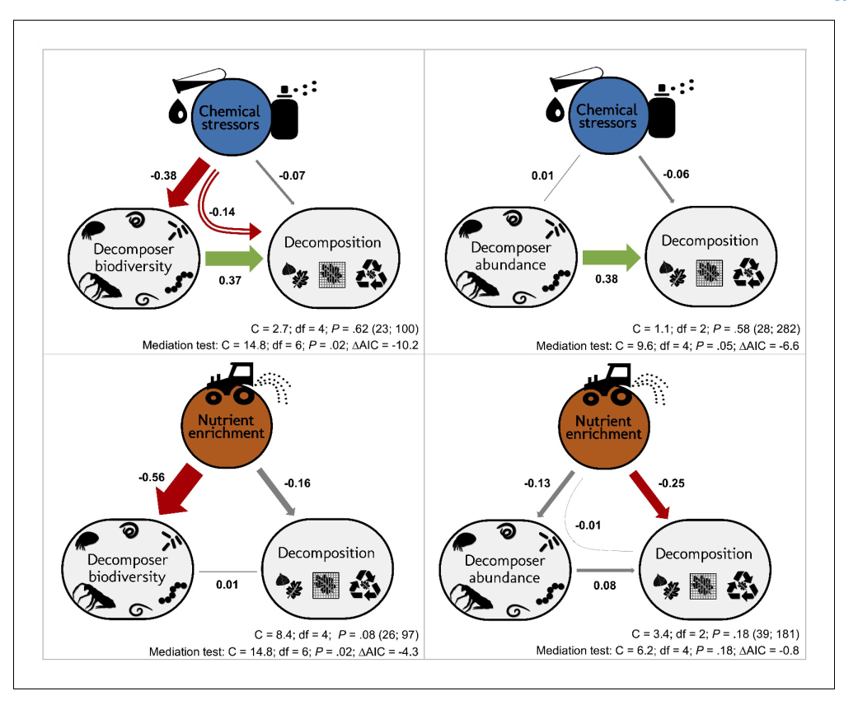

Applications in natural sciences
Ecosystem function
“declines in decomposer diversity and abundance explain reduced litter decomposition in response to stressors but not to nutrients”

Slide 18
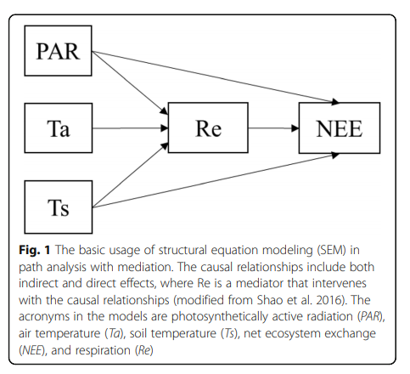
Back to the definition of SEM…
SEM are valuable because they provide a deeper understanding of the study system
SEM is made up of several model types (Shipley, 2004)
Correlation and linear regression are among its fundamental components
Fan et al. Ecological Processes (2016)

Slide 19
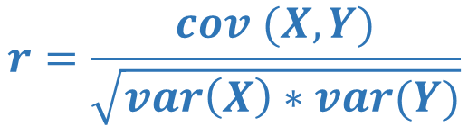
Correlation
Is a statistical measure that expresses the degree to which two variables are linearly related. In other words, it measures how much two variables change together
It ranges from 1 (positive correlation) to -1 (negative correlation)
Covariance between X and Y
$$r=\frac{cov (X,Y)}{\sqrt{var\left(X\right)∗var(Y)}}$$
Variance of X and Y

Slide 20
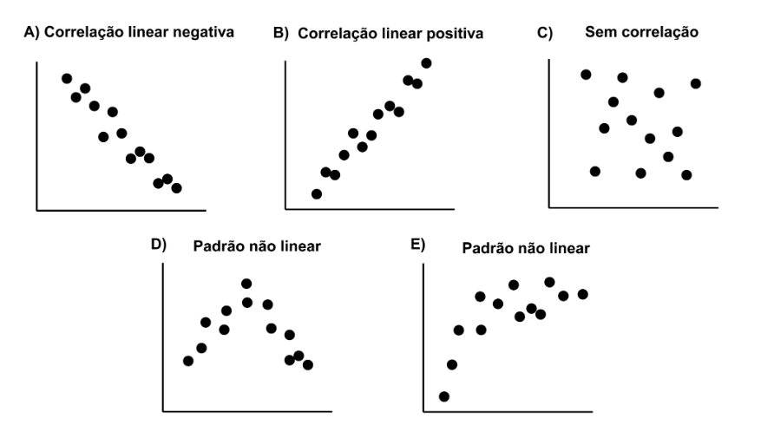
Correlation
Negative correlation Positive correlation Not correlated
Non linear patterns
Adapted from the book “Análises ecológicas no R”

Slide 21
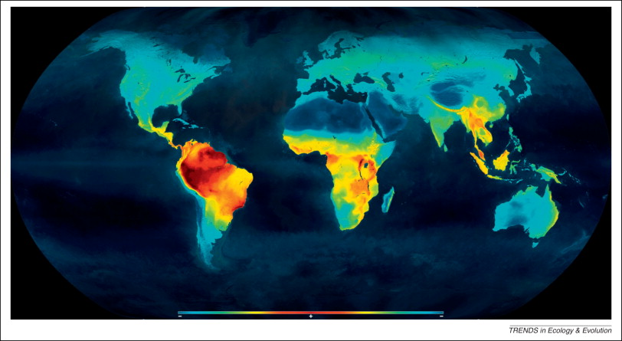
Mannion et al., 2014
- Diversity +
- Latitude +
- Diversity +
- Latitude +

Slide 22
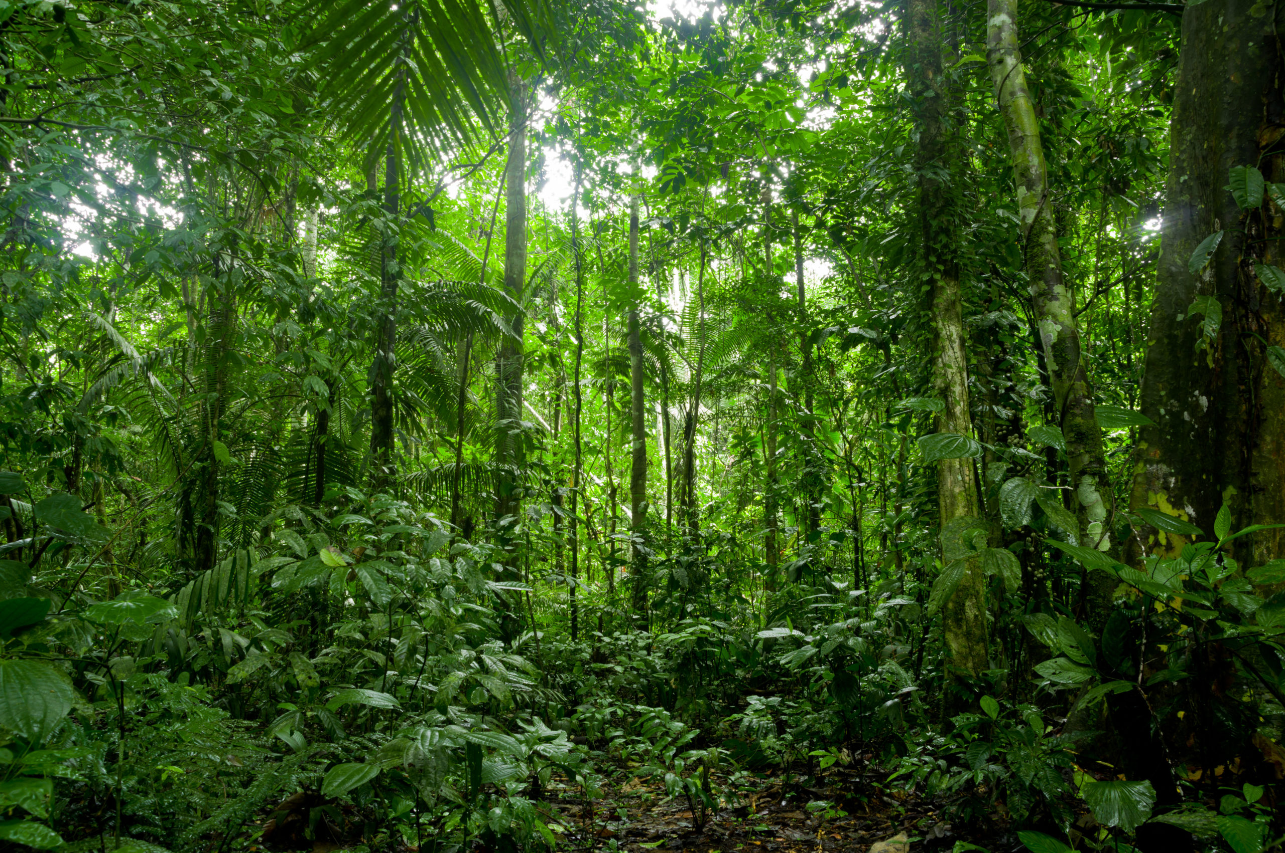
Hypothetical study on Amazonian bird diversity

Slide 23

Exercises
Ex 2: Correlation
We can test whether the bird diversity is somehow correlated to the distance from urban centers (variable “distance_city”)
Is there a correlation?
Is this relationship positive or negative?

Slide 24
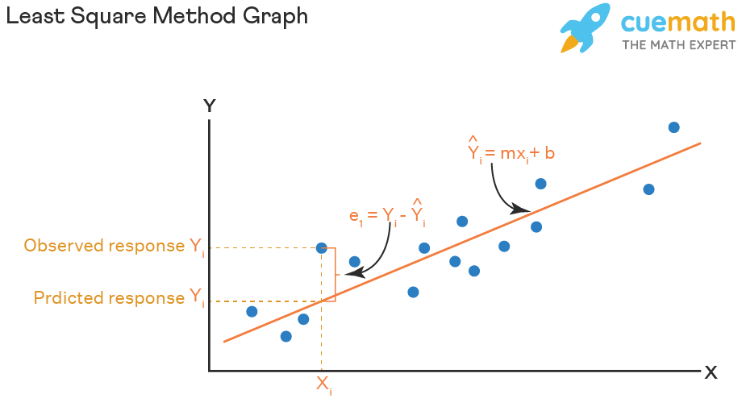


Linear regressions (simple and multiple)
Statistical method that models the relationship between two or more continuous variables
Determine the line that best fit the data from the following function
$$y=a+bx$$
$$γ=β0+β1x$$
intercept
Expected Y values (line)
slope

Slide 25

Linear regressions (simple and multiple)
Regression coefficients:
β or slope indicates the amount by which Y will change for each unit of change in X
β or slope is also called unstandardized coefficient because it is reported in raw units
R2: measures the goodness of fit of a model. Ranges from 0 to 1
$γ=β0+β1x$₁

Slide 26
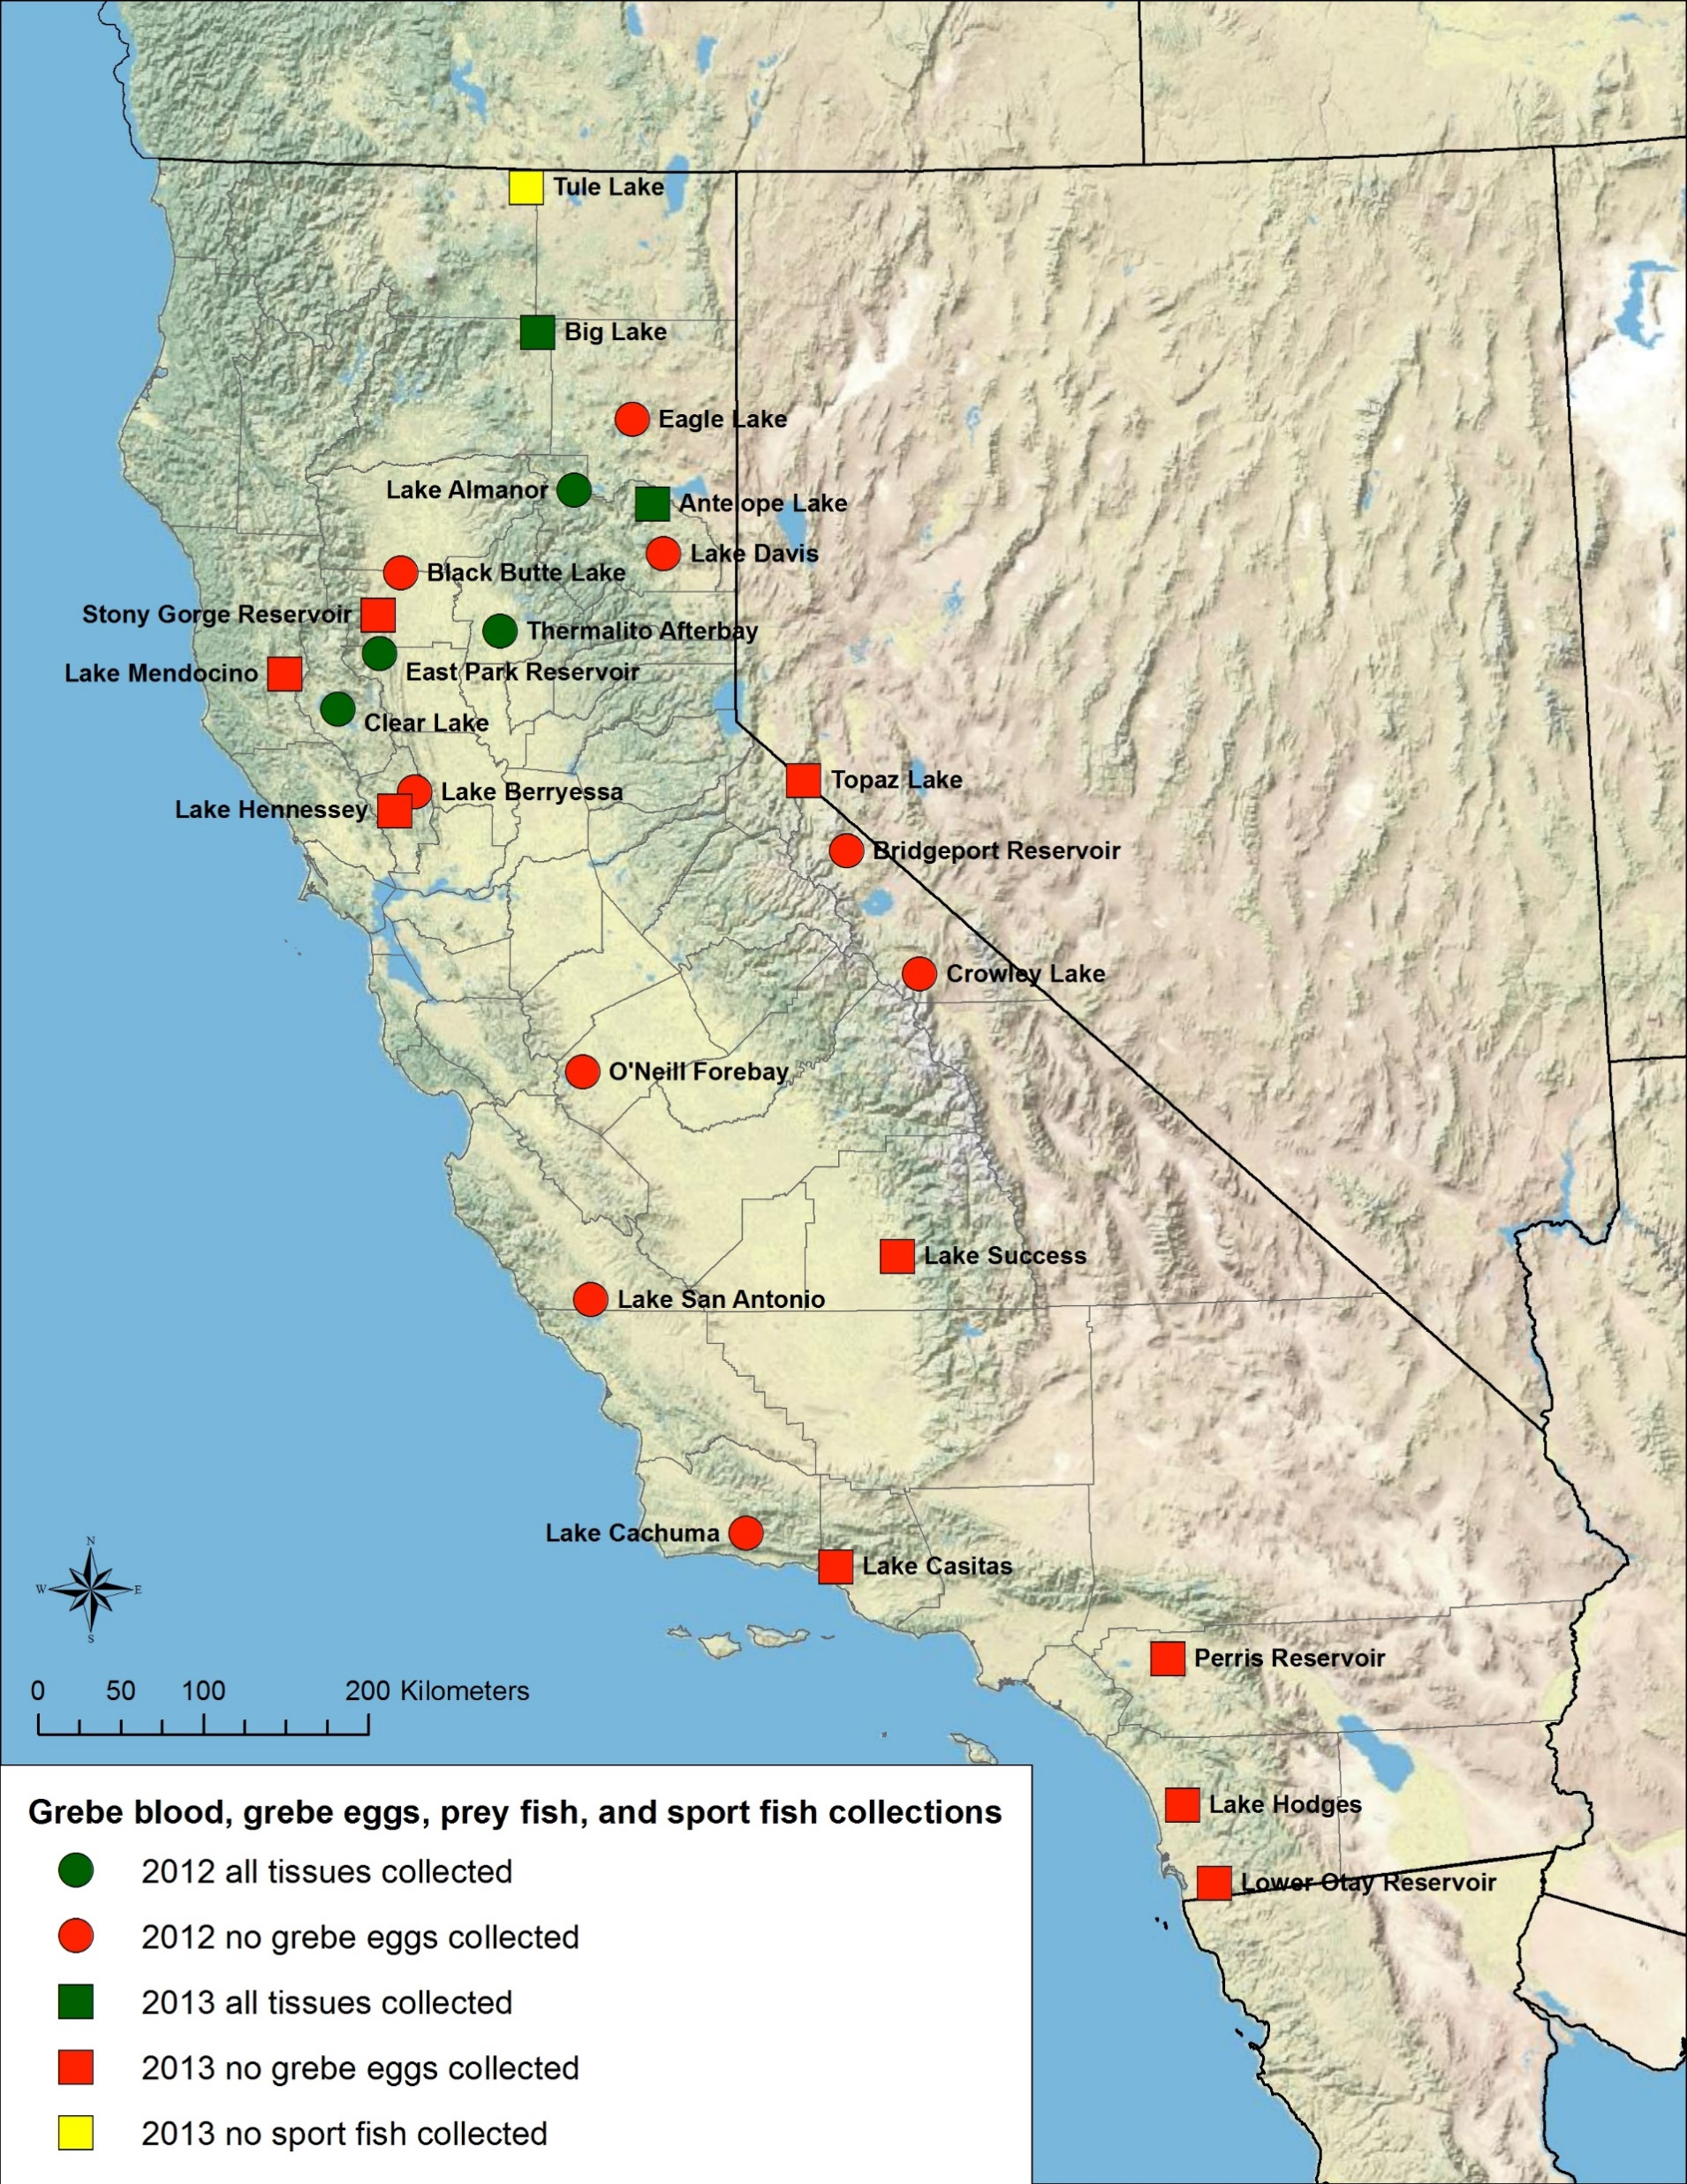
Linear regressions (simple and multiple)
Assumptions
Independence: Observations are independent of each other
https://www.usgs.gov/media/images/map-usgs-grebe-mercury-project-field-sites

Slide 27
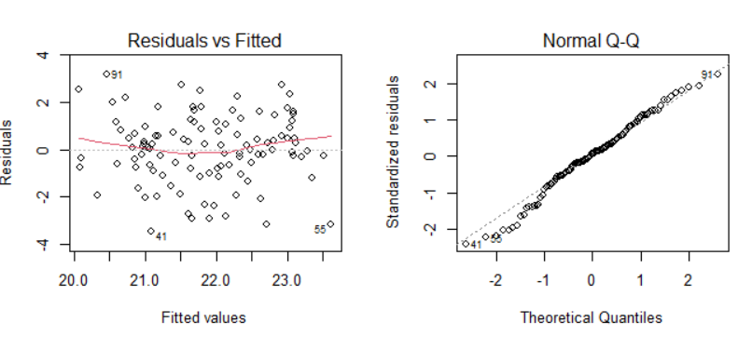
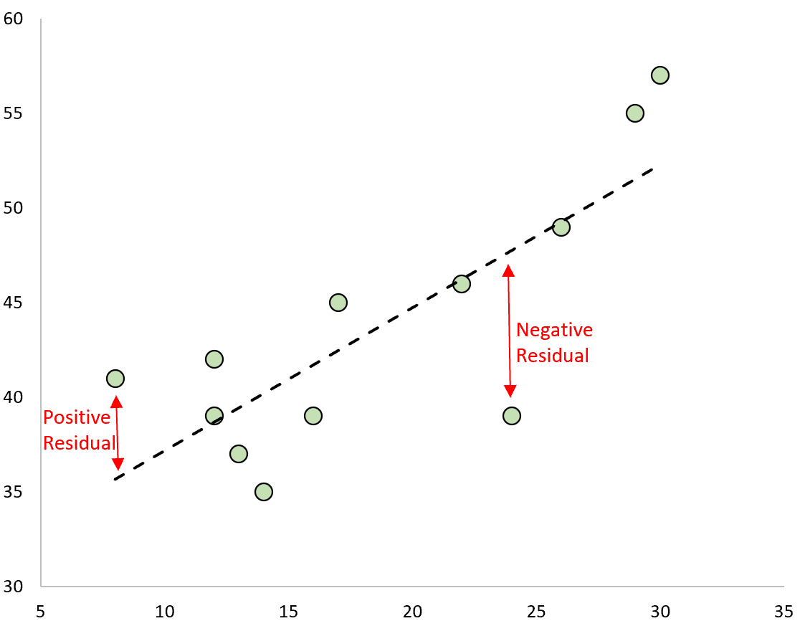
Linear regressions (simple and multiple)
Assumptions
Normality: residual normally distributed

Slide 28
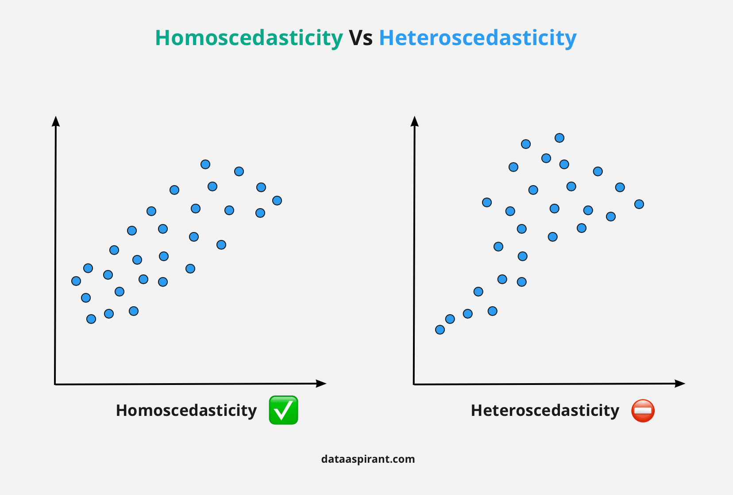
Linear regressions (simple and multiple)
Assumptions
Homoscedasticity: the variance of residual are homogeneous (the residuals vs fitted plot should resemble a starry sky – without an evident pattern)

Slide 29
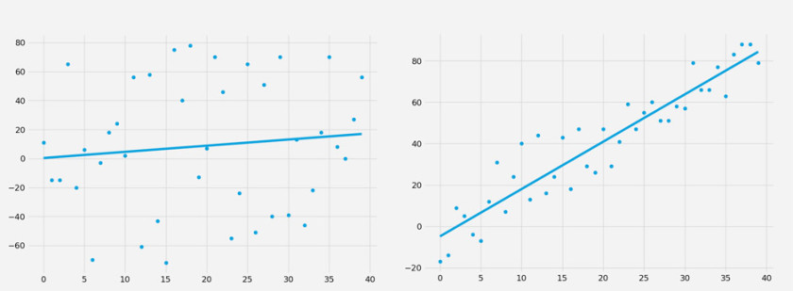
Linear regressions (simple and multiple)
Weaker relationship ☹
Stronger relationship ☺
https://evilspeculator.com/quantutorial-linear-regression/
R2
R2

Slide 30
Ex 3: Linear regression diagnosis
Based on two simulated data sets:
fit linear regression models
perform models diagnosis
compare models’ fit
Which of the models better meet the assumptions of a linear regression?
Which of the two models is better fitted?

Slide 31
Hypothetical study on Amazonian bird diversity

Slide 32
Exercises
Ex 4: Simple linear regression
The theory of island biogeography, proposed by MacArthur and Wilson (1967) states that species richness depends on the island’s size. Thus, larger islands harbor greater species richness. This theory has been widely applied in other ecological domains, for example, in landscape ecology to predict species diversity at patches of different sizes
Apply a simple linear regression (because our response variable is continuous) to test whether there is a relationship between the area of the forest patch and bird diversity
Does the model meet the linear regression assumptions (independence of observations, normality, homoscedasticity)?
Is there a significant association?
Is this association positive or negative?

Slide 33


Slide 34
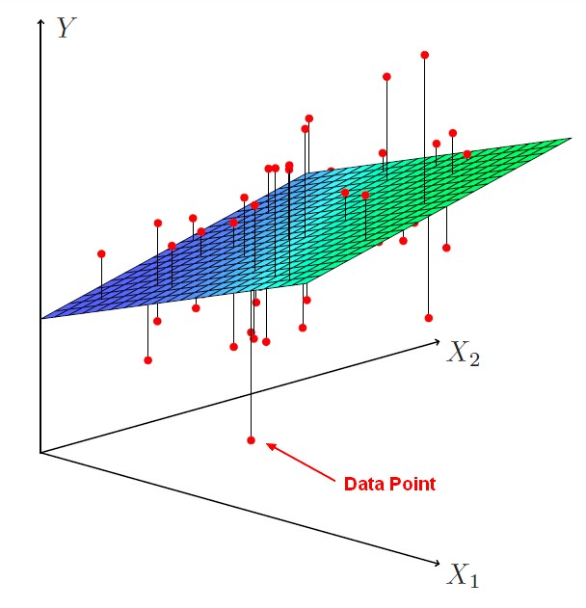

Linear regressions (simple and multiple)
Multiple linear regression:
Models the relationship between the dependent variable and two or more independent variables. In other words, estimates the value of the dependent variable based on two or more independent variables.
Assumptions: the same as for linear simple regression + independence of independent variables (non-collinearity)
https://datacadamia.com/data_mining/multiple_regression
$$γ=β0+β1x1+…+βnxn$$

Slide 35
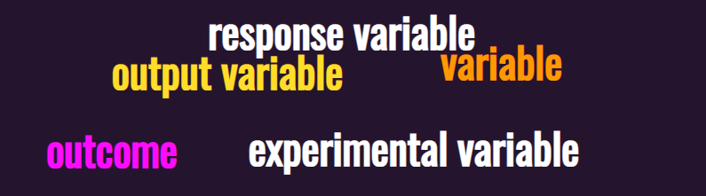
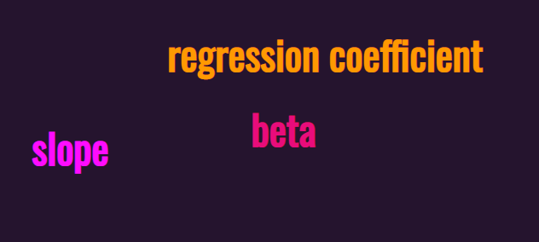
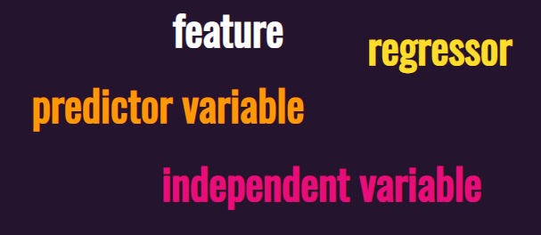
Remember: Statisticians are not very good at naming things…

Slide 36
Exercises
Ex 5: Multiple linear regression
Understanding the factors that drives diversity of communities lies at the heart of ecological research.
Apply a multiple linear regression (because our response variable is continuous) to understand whether bird diversity is explained by the area, tree diversity, arthropod biomass (i.e., food resources), bird nests and predators
Does the model meet the multiple regression assumptions (independence of observations, normality, homoscedasticity, no-multicollinearity among predictors)?
Which predictors have a significant impact on bird diversity?
Are these associations positive or negative?

Slide 37
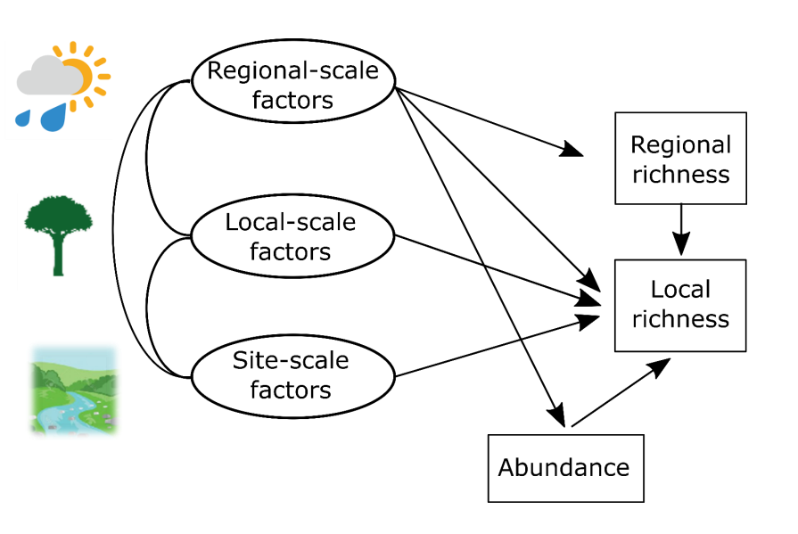
How SEM works?
Elaboration of a conceptual model
Evaluation of the adequacy of the conceptual model in relation to the observed data
Alves-Martins et al. 2018 Insect Conservation and Diversity

Slide 38

Conceptual model
The hypothesized causal relationships between the variables are specified by the conceptual model, which is entirely dependent on the researcher's knowledge of the system being studied
https://askabiologist.asu.edu/experiments/manduca

Slide 39
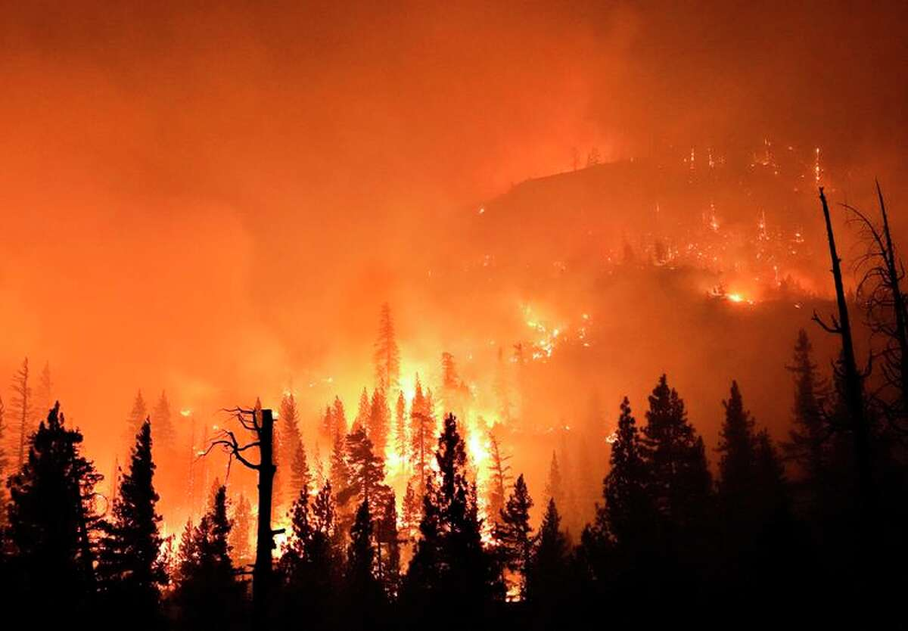
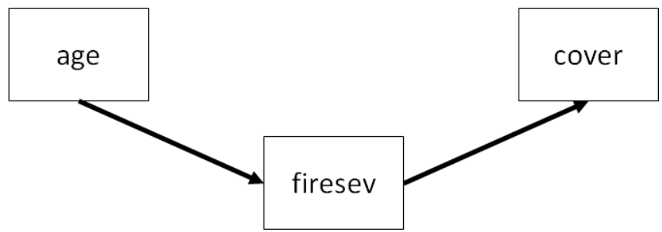
Conceptual model
https://jslefche.github.io/sem_book/local-estimation.html#tests-of-directed-separation
Source: San Francisco Chronicle

Slide 40
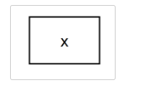

Graphical representation
Observed variables:
Effect direction:
https://cran.r-project.org/web/packages/tidySEM/vignettes/sem_graph.html

Slide 41
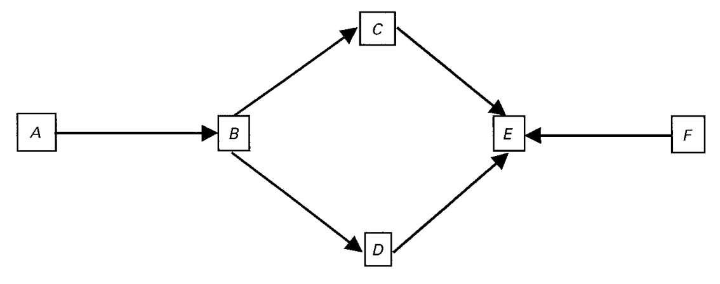
System of equations
B ~A
C~B
D~B
(4) E~C+D+F
Shipley, 2004

Slide 42
Piecewise SEM
Paths are estimated in individual models, and then pieced together to construct the structural model (Lefcheck, 2014)
Called piecewise SEM due to the nature by which the model is pieced together (Lefcheck, 2021)
Also called “local estimation” (Lefcheck, 2021)

Slide 43
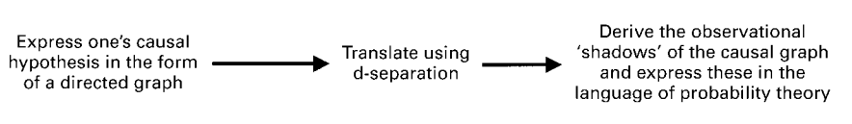
Piecewise SEM steps
Elaborate the conceptual model with the list of structural equations
Test data against structure
Interpret model results and overall fit

Slide 44

Direct and Indirect effects
PAR, Ta and Ts are independent
Re is dependent on PAR, Ta e Ts
Ta has an indirect effect on NEE conditional on Re
NEE depends on PAR, Re and Ts
Fan et al, 2016

Slide 45
Directed acyclic graphs (DAGs)
Graphical expression of the causal relationships between the measured variables
Endogenous variables
(response)
System of equations
B~A
C~B
D~B
E~C
E~D
F~E
Exogenous variables
(predictor)

Slide 46
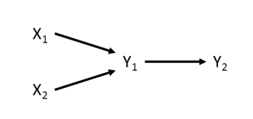
d-separation (Pearl, 1988)
Evaluates whether two variables become statistically independent after controlling for one or more variables
Y2 is causally independent of X1 conditional on Y1
Y2 is causally independent of X2 conditional on Y1

Slide 47
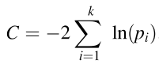
d-separation: Basis set
Non-adjacent variables | Parent variable of either non-adjacent variable | d-separation
X1, X2 |  | X1 ~ X2
X1, Y2 | Y1 | X1~Y2+Y1
X2, Y2 | Y1 | X2~Y2+Y1
https://jonlefcheck.net/2014/07/06/piecewise-structural-equation-modeling-in-ecological-research/
List all variable pairs without arrows between them
Run regression models (for this non-adjacent variables) and extract associated p-values
Calculate Fisher's C Statistic
Chi-Square distribution with 2k degrees of freedom (k=number of pairs in the basis set)

Slide 48
d-separation: Basis set
If p > 0.05 = The observed model is equal to the conceptual model
Interpret model results and overall fit
If p < 0.05 = The observed model is different from the conceptual model
Add missing paths until p>0.05 and THEN
Interpret model results and overall fit

Slide 49
Piecewise SEM steps
Elaborate the conceptual model
Test of independence of variables in the system of equations with d-separation (use the function psem)
If C Fishers’s
p value < 0.05, modify the model (include paths based on the “Test of direct separation” ) until get p values > 0.05
Interpret model results and overall fit

Slide 50
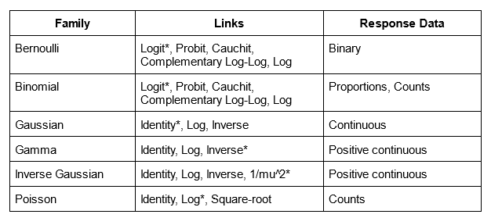

PiecewiseSEM assumptions
The data must meet the assumption of the individual models (dependent on each individual model)
https://jasp-stats.org/

Slide 51
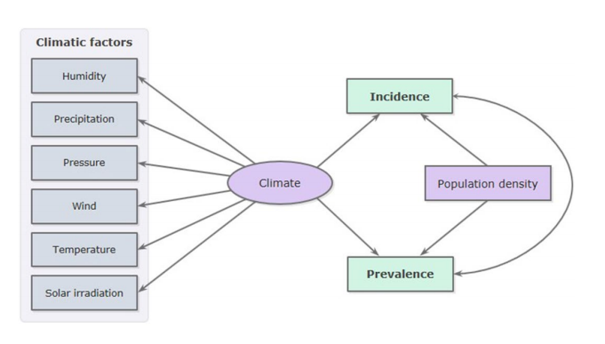
Benefits and drawbacks of the Piecewise Approach
Benefits:
Does not require quite a large sample size
Accept non-normal distributions
Poisson, binomial, etc
Drawback:
Not applicable in models that include latent variables (which cannot be directly observed or measured)
Spada et al. 2021 Scientific reports

Slide 52
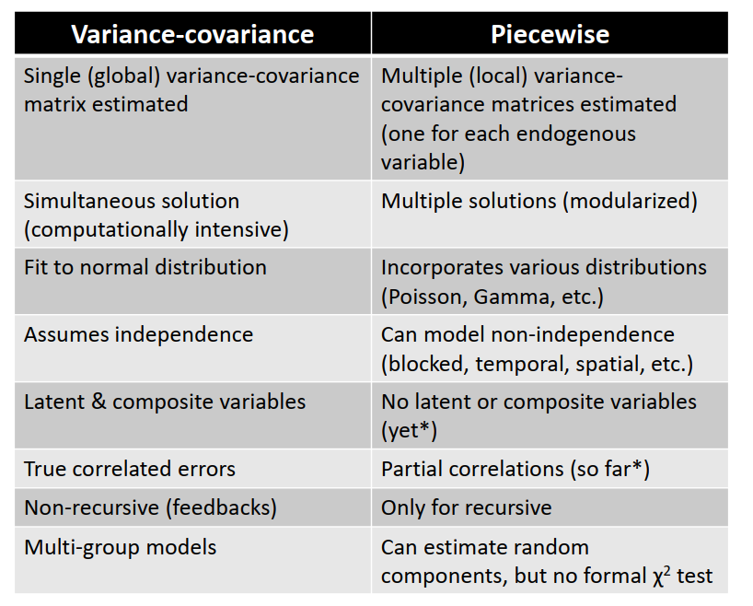


Traditional vs PiecewiseSEM
DataCamp
Source: John Lefcheck

Slide 53


Slide 54
Ex 6: PiecewiseSEM:
Objective: understand patterns in plant diversity following disturbance, in this case wildfires in California.
We hypothesize that fire severity increases with stand age, and that plot cover will be determined by fire severity
Source: San Francisco Chronicle
https://jslefche.github.io/sem_book/local-estimation.html#tests-of-directed-separation

Slide 55
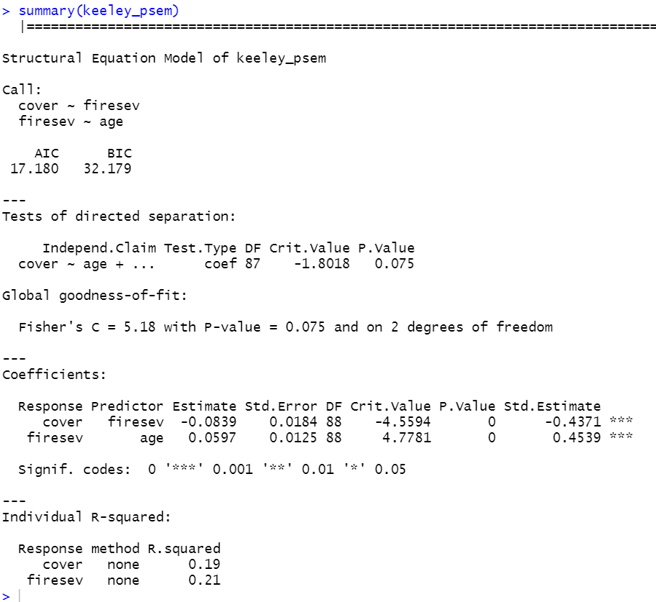


Slide 56
Final model:
D-sep: Fisher C = 5.18, p>0.075
R2 = 0.19
R2 = 0.21
0.454***
-0.437***
Source: San Francisco Chronicle

Slide 57
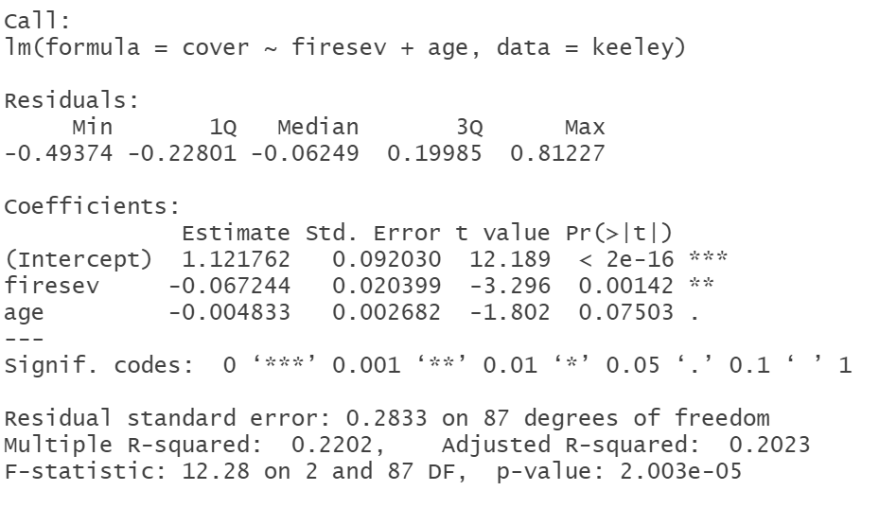
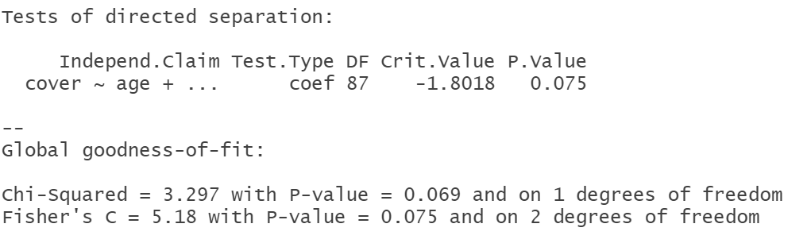
Now, do a d-separation by hand and compare to the “psem” summary

Slide 58
Ex 6: PiecewiseSEM
Objective: Evaluate the relative importance of climate, local environmental conditions and abundance in the richness of zygoptera communities in Amazonian streams
Hypothesis: Local species richness is determined by species abundance, which in turn, is influenced by large-scale processes such as climate
Temperature
seasonality
EVI
Precipitation
seasonality
Abundance
Local
richness
Stream depth
AET
Stream width

Slide 59
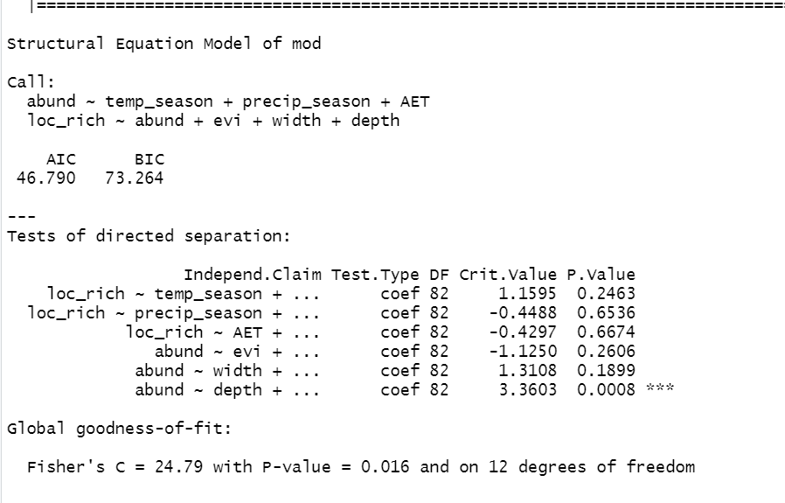
p < 0.05 → add missing paths one by one

Slide 60
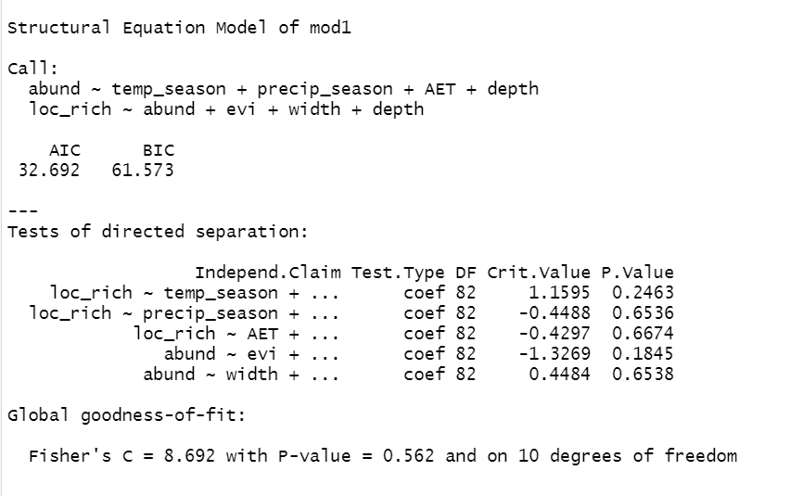

Slide 61
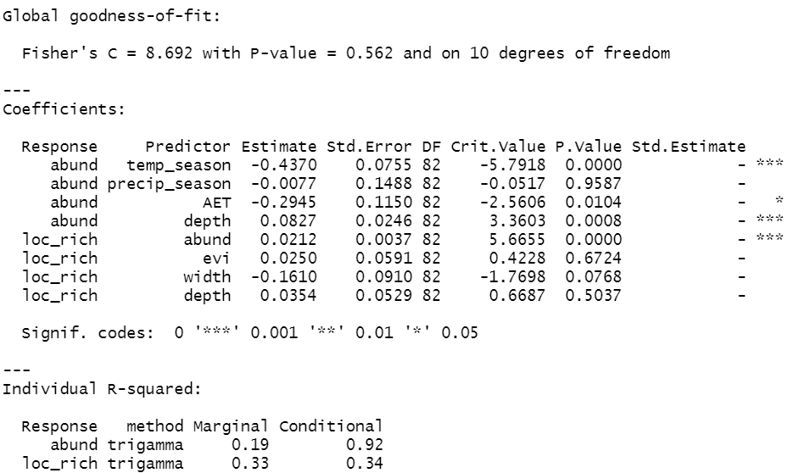

Slide 62
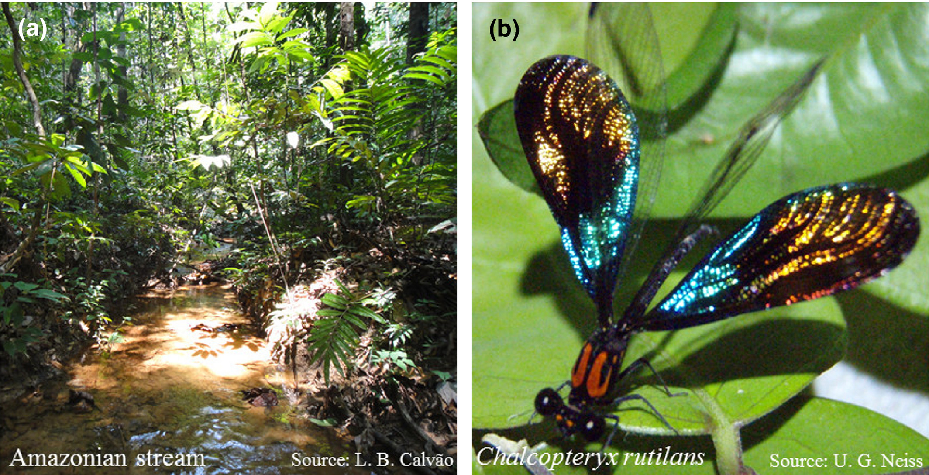
Final model:
Temperature seasonality
EVI
-0.51***
Water width
R2 = 0.33
R2 = 0.19
Precipitation seasonality
Relative abundance
Riqueza
0.61***
-0.34*
0.09***
AET
Water depth
D-sep: Fisher's C = 8.692, p-value = 0.562

Slide 63
Hypothetical study on Amazonian bird diversity

Slide 64
Ex 7: Disentangle the mechanisms underlying insectivorous bird diversity in a tropical forest system
Distance to city
Tree diversity
Arthropod biomass
Bird diversity
Habitat type

Slide 65
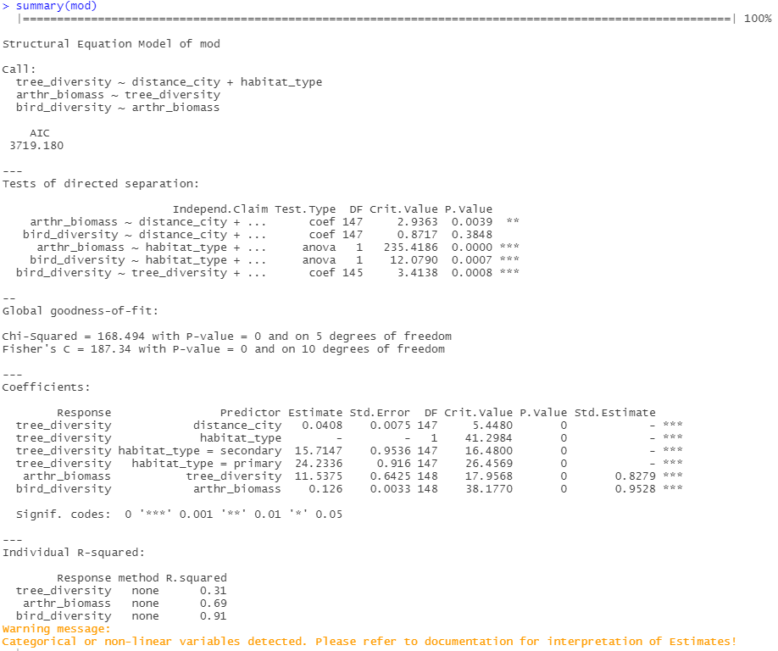

p < 0.05 → add missing paths one by one

Slide 66
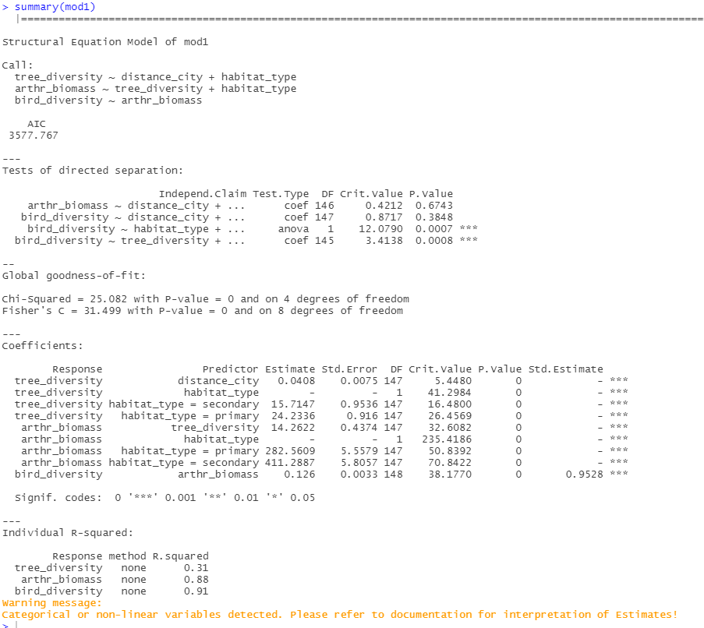
p < 0.05 → add missing paths one by one

Slide 67
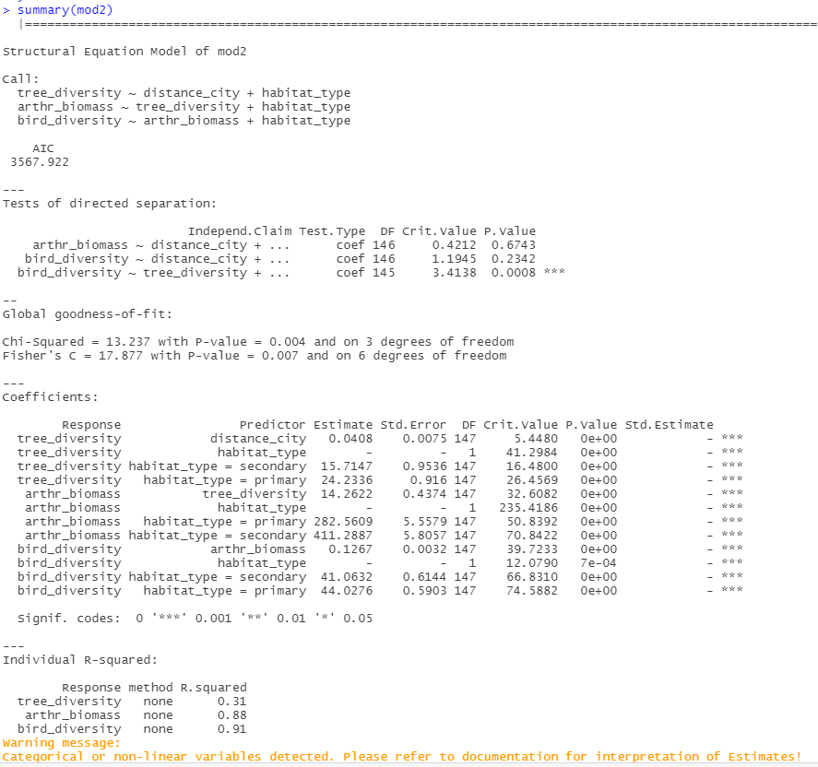
p < 0.05 → add missing paths one by one

Slide 68
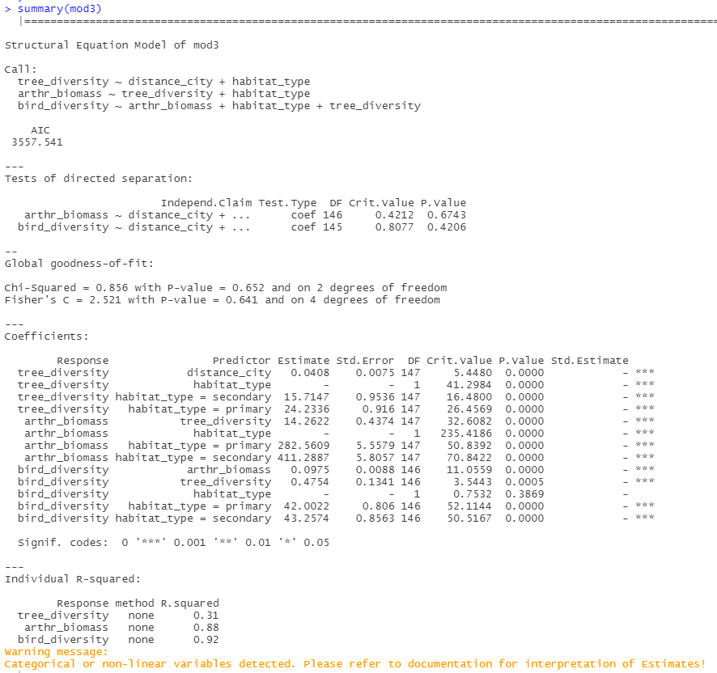

Slide 69


Slide 70
References
Alves‐Martins, F., Calatayud, J., Medina, N.G., De Marco, P., Juen, L., Hortal, J., 2019. Drivers of regional and local diversity of Amazonian stream Odonata. Insect Conserv Divers 12, 251–261. https://doi.org/10.1111/icad.12327
Beaumelle, L., De Laender, F., Eisenhauer, N., 2020. Biodiversity mediates the effects of stressors but not nutrients on litter decomposition. eLife 9, e55659. https://doi.org/10.7554/eLife.55659
Boaratti, A.Z., Da Silva, F.R., 2015. Relationships between environmental gradients and geographic variation in the intraspecific body size of three species of frogs (Anura): Geographic Variation of Frog’s Body Size. Austral Ecology 40, 869–876. https://doi.org/10.1111/aec.12267
Bowen, J.L., Kearns, P.J., Byrnes, J.E.K., Wigginton, S., Allen, W.J., Greenwood, M., Tran, K., Yu, J., Cronin, J.T., Meyerson, L.A., 2017. Lineage overwhelms environmental conditions in determining rhizosphere bacterial community structure in a cosmopolitan invasive plant. Nat Commun 8, 433. https://doi.org/10.1038/s41467-017-00626-0
Desbiens, A.A., Roff, G., Robbins, W.D., Taylor, B.M., Castro‐Sanguino, C., Dempsey, A., Mumby, P.J., 2021. Revisiting the paradigm of shark‐driven trophic cascades in coral reef ecosystems. Ecology 102. https://doi.org/10.1002/ecy.3303
dos Santos Costa, A., Stropp, J., de Carvalho, N.A., Alves-Martins, F., Ladle, R.J., Malhado, A.C.M., 2020. Environmental correlates of seed weight of tropical semi-arid woody species. Plant Soil 446, 369–378. https://doi.org/10.1007/s11104-019-04341-1
Fan, Y., Chen, J., Shirkey, G., John, R., Wu, S.R., Park, H., Shao, C., 2016. Applications of structural equation modeling (SEM) in ecological studies: an updated review. Ecol Process 5, 19. https://doi.org/10.1186/s13717-016-0063-3
Grace, J.B., 2006. Structural equation modeling and natural systems. Cambridge University Press, Cambridge, UK ; New York.
Mannion, P.D., Upchurch, P., Benson, R.B.J., Goswami, A., 2014. The latitudinal biodiversity gradient through deep time. Trends in Ecology & Evolution 29, 42–50. https://doi.org/10.1016/j.tree.2013.09.012

Slide 71
References
Nakadai, R., 2023. Macroecological processes drive spiritual ecosystem services obtained from giant trees. Nat. Plants 9, 209–213. https://doi.org/10.1038/s41477-022-01337-1
Lefcheck, J.S., 2016. piecewiseSEM : Piecewise structural equation modelling in r for ecology, evolution, and systematics. Methods Ecol Evol 7, 573–579. https://doi.org/10.1111/2041-210X.12512
Rodrigues da Silva, F., Gonçalves-Souza, T., Brant Paterno, G., Borges Provete, D., Humberto Vancine, M., 2022. Análises ecológicas no R, 1st ed. Canal 6 Editora. https://doi.org/10.52050/9788579175633
Shipley, B., 2004. Cause and correlation in biology: a user’s guide to path analysis, structural equations and causal inference, 1. paperback ed., with corr., transferred to digital print. ed. Cambridge Univ. Press, Cambridge.
Spada, A., Tucci, F.A., Ummarino, A., Ciavarella, P.P., Calà, N., Troiano, V., Caputo, M., Ianzano, R., Corbo, S., de Biase, M., Fascia, N., Forte, C., Gambacorta, G., Maccione, G., Prencipe, G., Tomaiuolo, M., Tucci, A., 2021. Structural equation modeling to shed light on the controversial role of climate on the spread of SARS-CoV-2. Sci Rep 11, 8358. https://doi.org/10.1038/s41598-021-87113-1
Teixeira, L., Tisovec‐Dufner, K.C., Marin, G. de L., Marchini, S., Dorresteijn, I., Pardini, R., 2021. Linking human and ecological components to understand human–wildlife conflicts across landscapes and species. Conservation Biology 35, 285–296. https://doi.org/10.1111/cobi.13537
Wan, N.-F., Fu, L., Dainese, M., Hu, Y.-Q., Pødenphant Kiær, L., Isbell, F., Scherber, C., 2022. Plant genetic diversity affects multiple trophic levels and trophic interactions. Nat Commun 13, 7312. https://doi.org/10.1038/s41467-022-35087-7

Slide 72
References
Wang, Y.X.G., Matson, K.D., Prins, H.H.T., Xu, Y., Huang, Z.Y.X., de Boer, W.F., 2023. Risk factors for Lyme disease: A scale-dependent effect of host species diversity and a consistent negative effect of host phylogenetic diversity. Ticks and Tick-borne Diseases 14, 102073. https://doi.org/10.1016/j.ttbdis.2022.102073
Zizka, A., Onstein, R.E., Rozzi, R., Weigelt, P., Kreft, H., Steinbauer, M.J., Bruelheide, H., Lens, F., 2022. The evolution of insular woodiness. Proc. Natl. Acad. Sci. U.S.A. 119, e2208629119. https://doi.org/10.1073/pnas.2208629119

Slide 73
Websites
https://jonlefcheck.net/2014/07/06/piecewise-structural-equation-modeling-in-ecological-research/
https://jslefche.github.io/sem_book/
https://analises-ecologicas.com/

